Slide 1







STACK OVERFLOW DEVELOPER SURVEY 2019
La Phu Hao
September 27, 2023

Slide 2



OUTLINE
Executive Summary
Introduction
Methodology
Results
Visualization – Charts
Dashboard
Discussion
Findings & Implications
Conclusion
Appendix

Slide 3

EXECUTIVE SUMMARY
Data contextualization and analysis goal.
Methodology description.
Data gathering.
Data analysis.
Data visualizations.
Results presentation supported with graphs and trends.
Discussion of overall findings and implications regarding the results previously exposed.
Conclusions of the carried out research.

Slide 4

INTRODUCTION
Stack Overflow’s annual Developer Survey is the largest and the most comprehensive survey of people who code around the world.
Results don’t represent everyone in the developer community evenly.
Nearly 90,000 developers.
Trends to predict where the developers are going.
Characterization of developers around the globe.

Slide 5

METHODOLOGY
Collect survey data & explore its content
Web Scraping
APIs.
Request library.
Data Wrangling
Exploratory data analysis
Analyzing data distribution.
Handling outliers.
Correlations.
Data Visualization
Highlight data distribution, relationships, composition, and data comparison.
Dashboards.

Slide 6

RESULTS

Slide 7
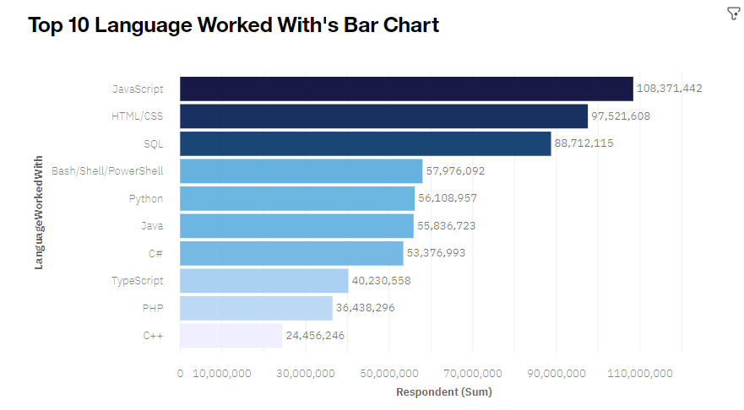
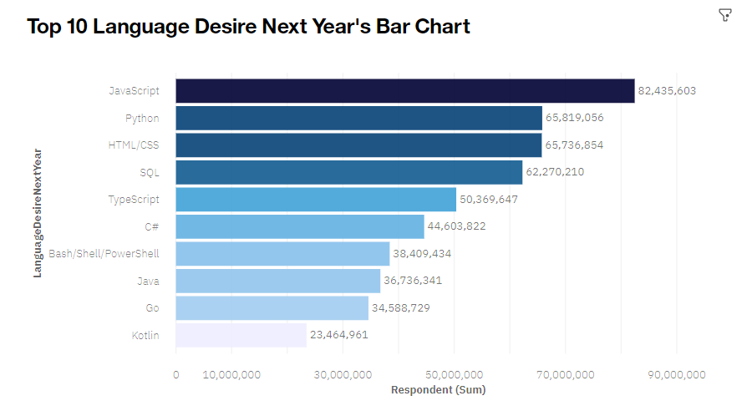
PROGRAMMING LANGUAGE TRENDS
Current Year
Next Year

Slide 8
PROGRAMMING LANGUAGE TRENDS - FINDINGS & IMPLICATIONS
Findings
JavaScript seems to keep as leading language.
Python fastest-growing.
Great interest in TypeScript.
Implications
Possible developer migration from JavaScript to TypeScript.

Slide 9
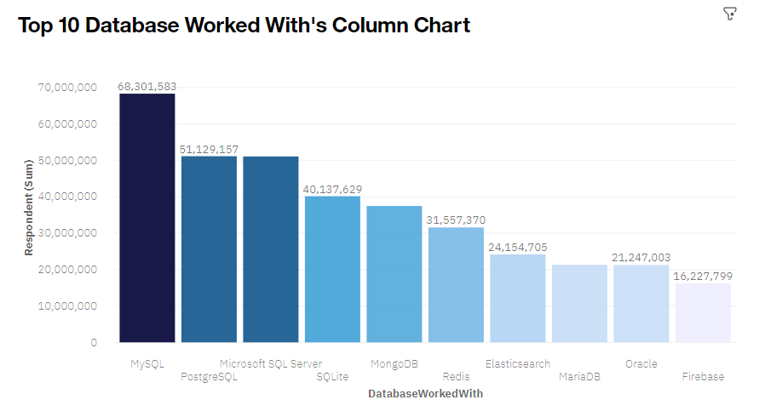
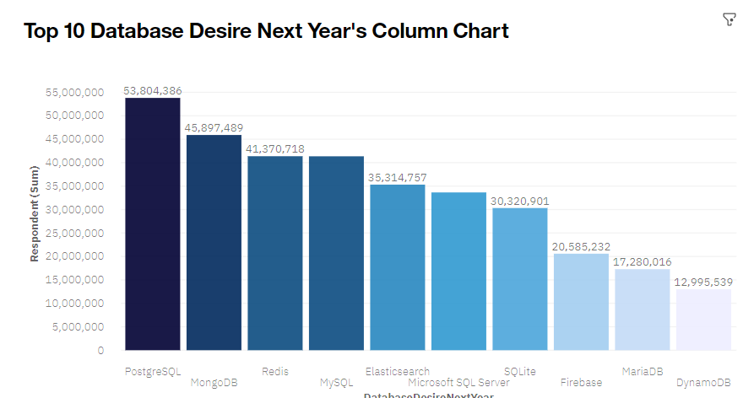
DATABASE TRENDS
Current Year
Next Year

Slide 10
DATABASE TRENDS - FINDINGS & IMPLICATIONS
Findings
MySQL as most used database.
Lack of interest in Microsoft SQL Server and SQLite.
Increasing interest in PostgreSQL and MongoDB.
Implications
Microsoft SQL Server and SQLite losing ground in the market.
PostgreSQL and MongoDB establishment in the market.

Slide 11

DASHBOARD
https://dataplatform.cloud.ibm.com/dashboards/84b03464-a5bf-4889-a110-d9c606b59917/view/6f36f53d3c8d30c871e6cce407cc7e527a34240bb4bb8b50888c7b495c692297f36f1498c87d485cd9420d31f5bf17589b

Slide 12
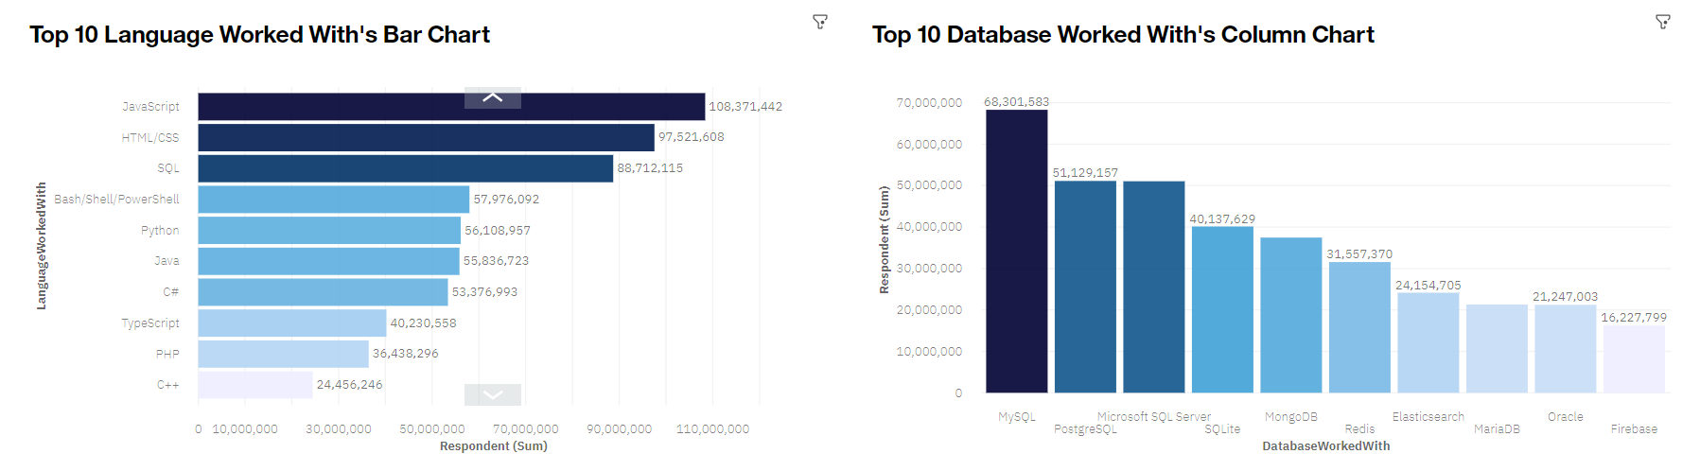
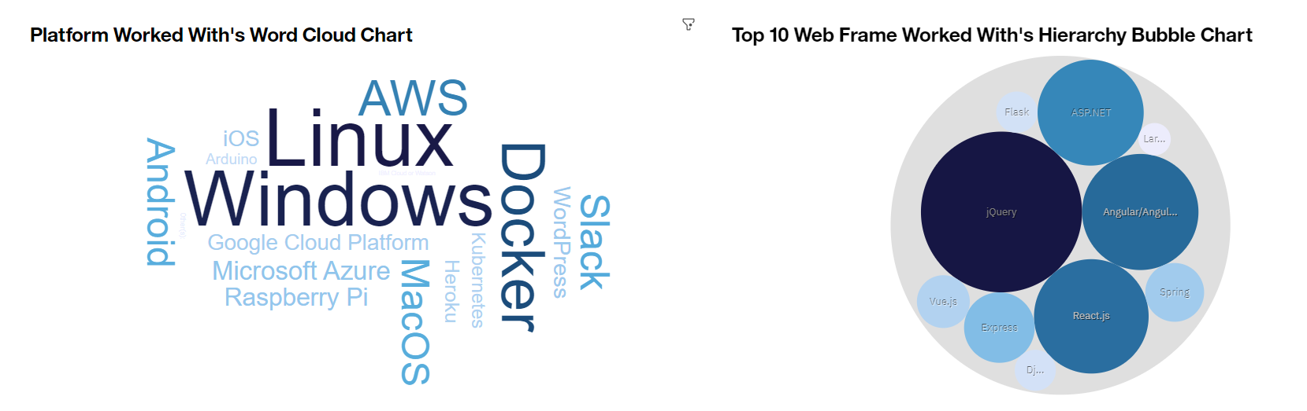
CURRENT TECHNOLOGY USAGE

Slide 13
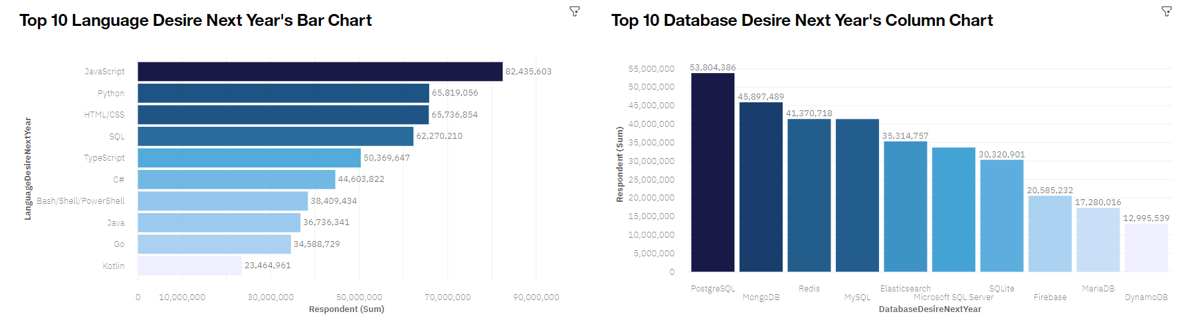
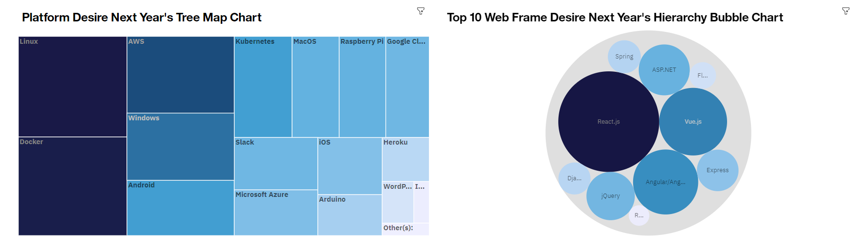
FUTURE TECHNOLOGY TREND

Slide 14
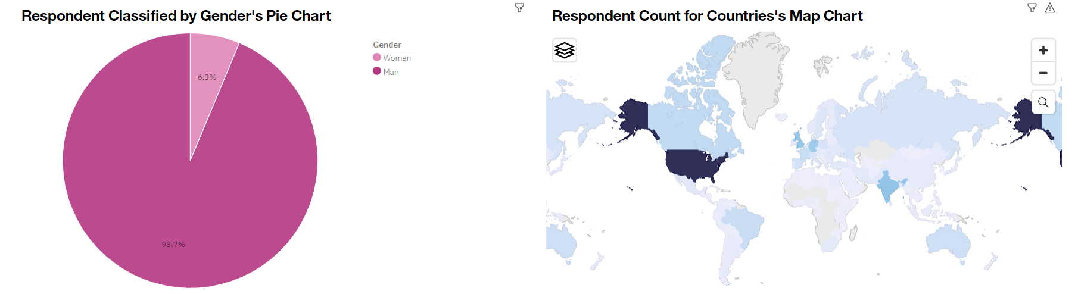
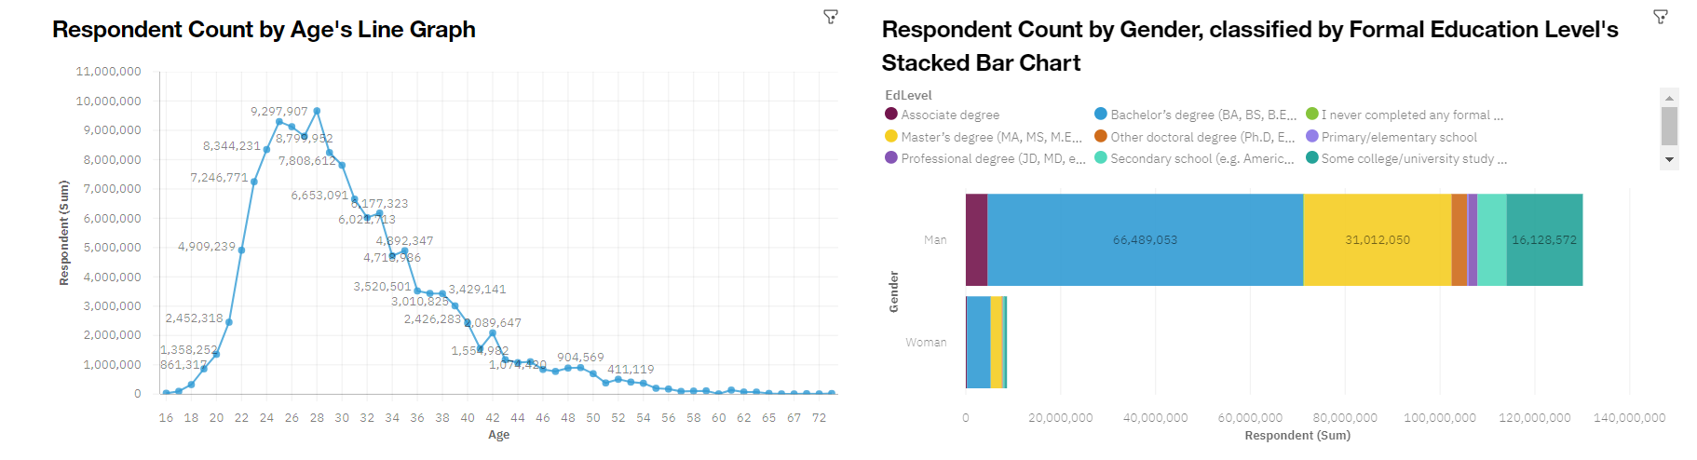
DEMOGRAPHICS

Slide 15
DISCUSSION

Slide 16
OVERALL FINDINGS & IMPLICATIONS
Findings
JavaScript is widely used and TypeScript getting popular.
Over 90% of young male developers.
Developers are mostly located in developed countries.
Implications
JavaScript and TypeScript web frames gaining followers.
Global polarization of developer location and gender.
Young developers without postgrad studies on its majority.

Slide 17

CONCLUSION
Developers are people with very marked characteristics.
A good idea of the popularity trends of different tools, platforms, and languages can be obtained.
There is a job to be done to spread accessibility of this labor market to countries in development.

Slide 18

APPENDIX

Slide 19
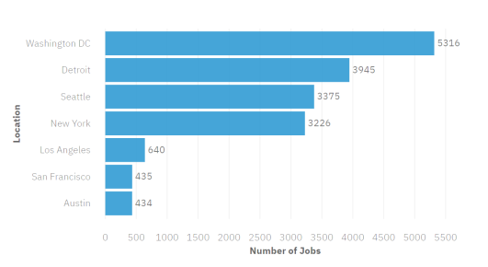
JOB POSTINGS
In Module 1 you have collected the job posting data using Job API in a file named “job-postings.xlsx”. Present that data using a bar chart here. Order the bar chart in the descending order of the number of job postings.

Slide 20
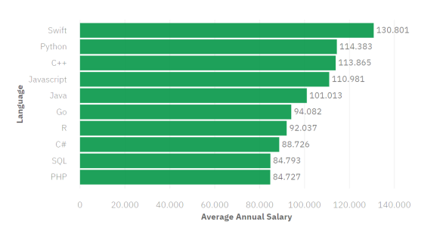
POPULAR LANGUAGES
In Module 1 you have collected the job postings data using web scraping in a file named “popular-languages.csv”. Present that data using a bar chart here. Order the bar chart in the descending order of salary.

